Slide 1
Group 4
Divesh Mohan
Chai Yi Bing
Lee Chee Hong

Slide 2
Introduction
Background Problem
Research Question
How to implement a notify function into the desktop application?
Who will be able to update the class booking desktop application rephrase?
What will help generating timetable to the newest and analysis report?
Objective
To design a convenient class booking desktop application for INTI admins
To develop a desktop application which allows users to check for class booking information
To implement a notification pop ups to remind admins about their booking
Limitations
-Desktop App

Slide 3




Literature Review
CRUD
Data Visualization

Slide 4
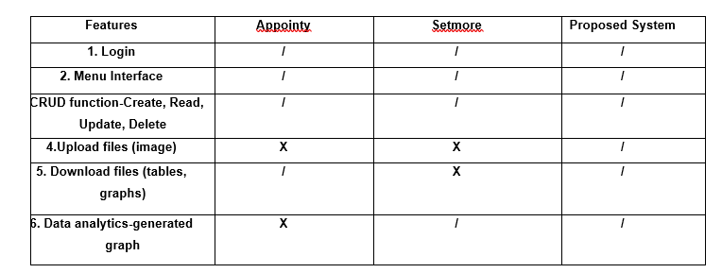
Litreature review
System Analysis

Slide 5
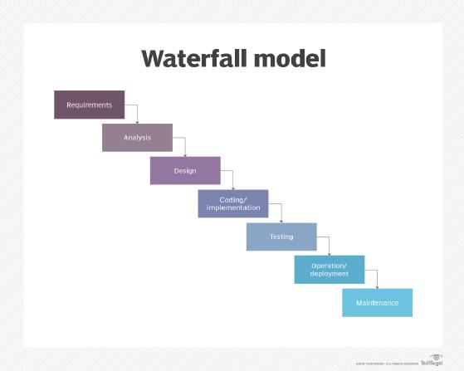
Methodlogy
Waterfall Model

Slide 6
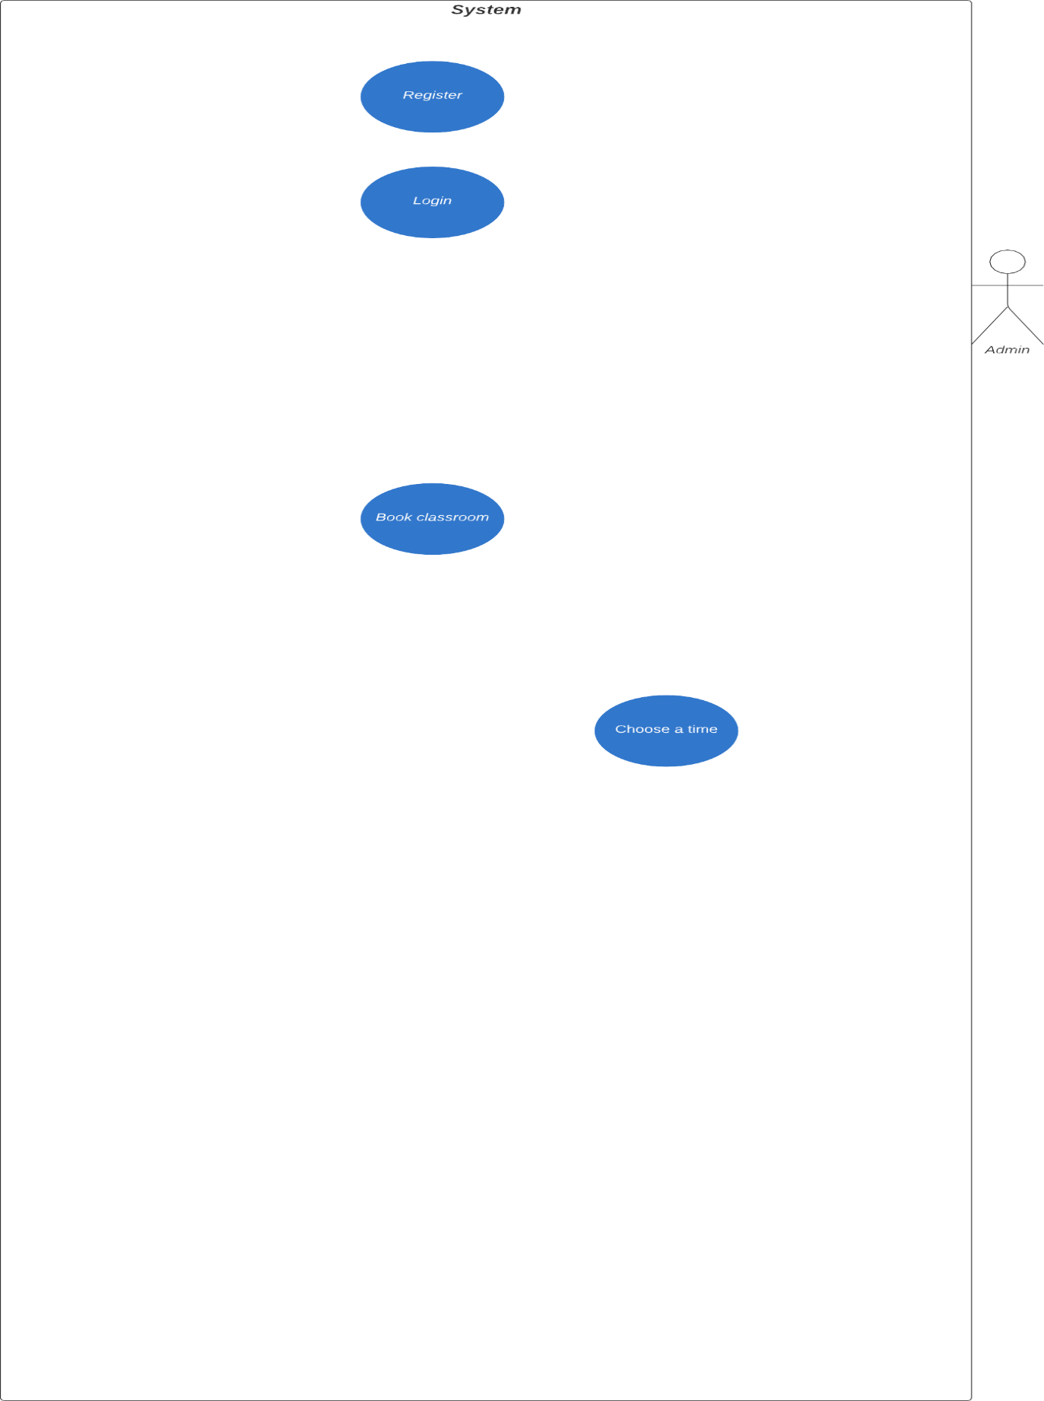

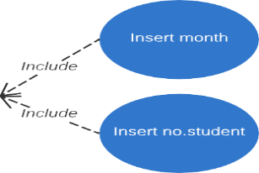
Use case diagram

Slide 7
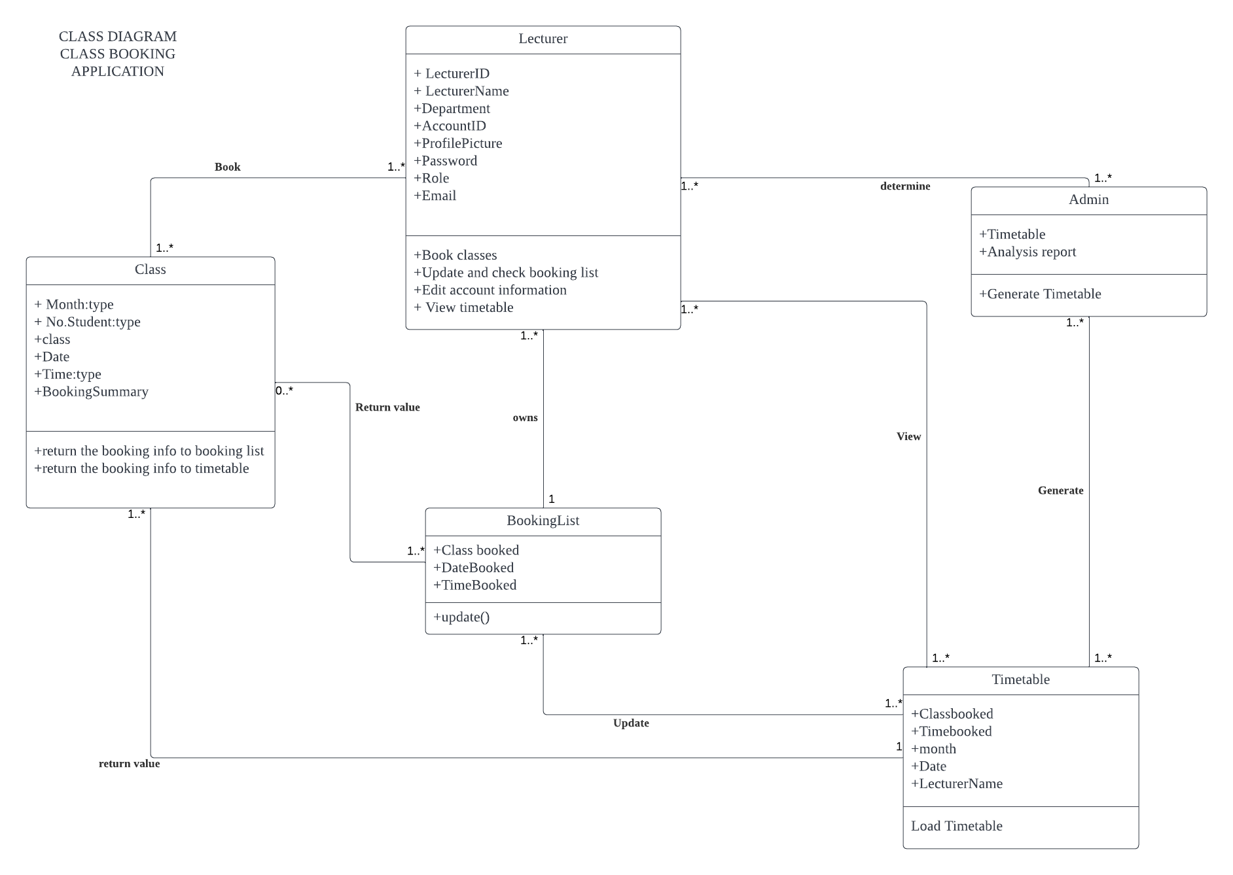
Class diagram

Slide 8
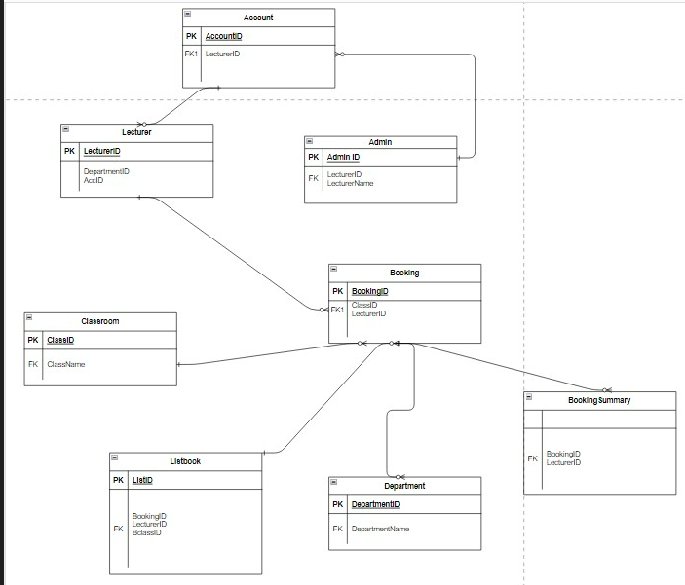
ER Diagram

Slide 9
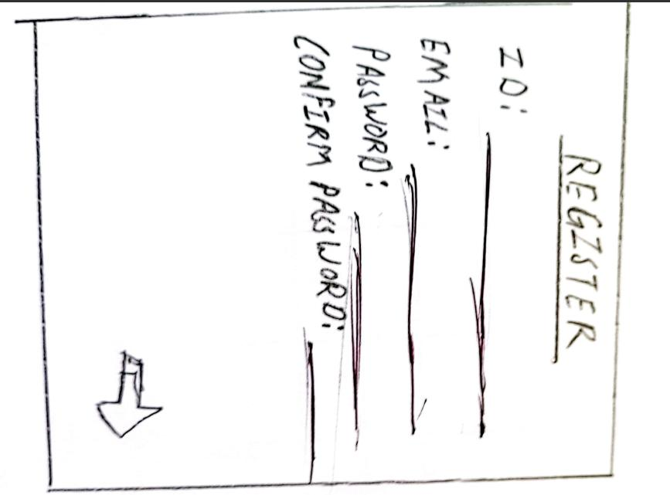
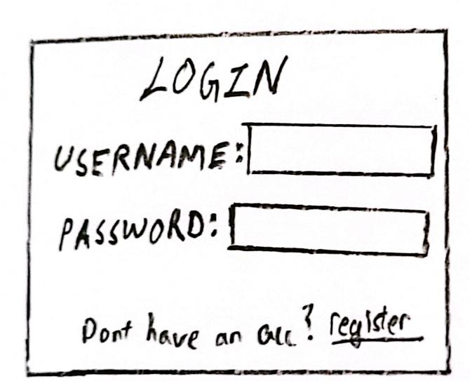
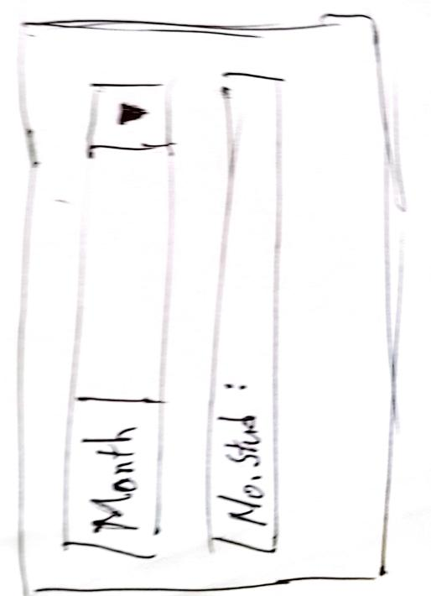
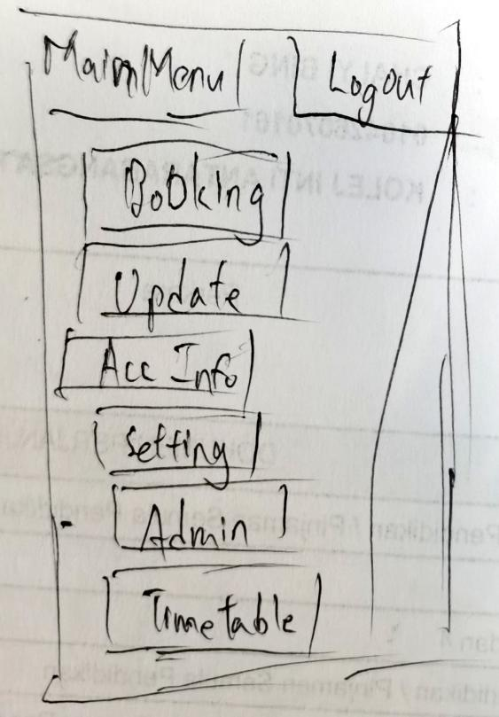
Methodology
(Low Fidelity Prototype)

Slide 10
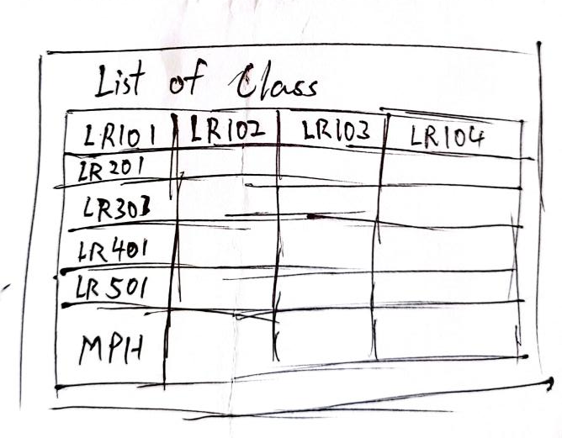
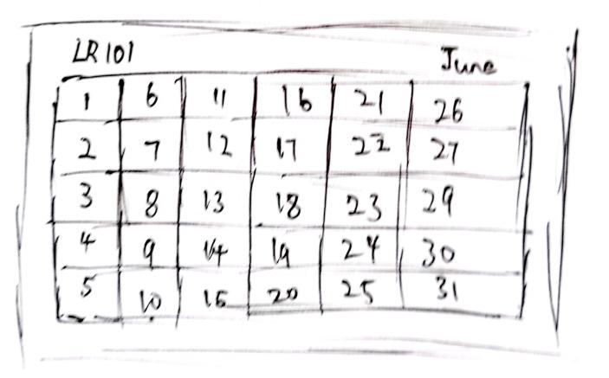
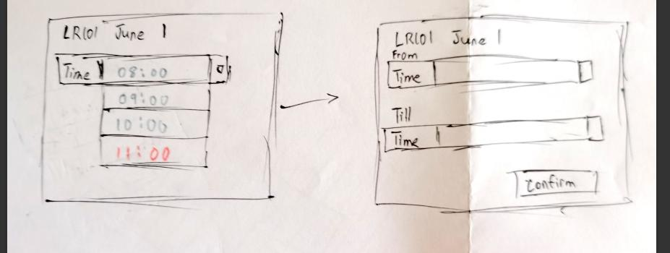
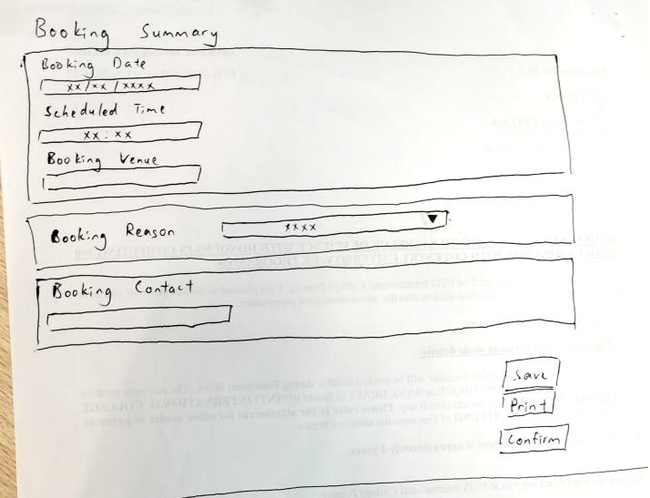
Methodology
(Low Fidelity Prototype)

Slide 11
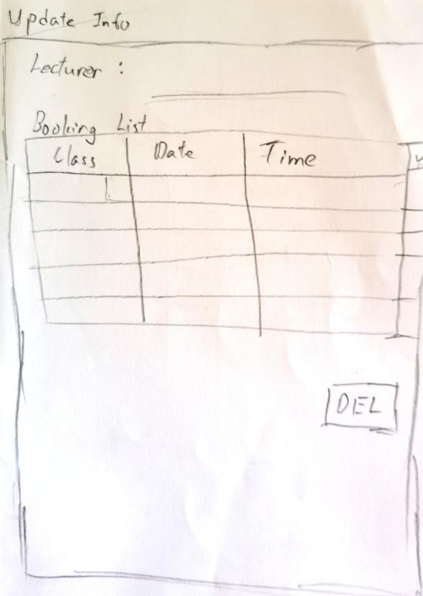
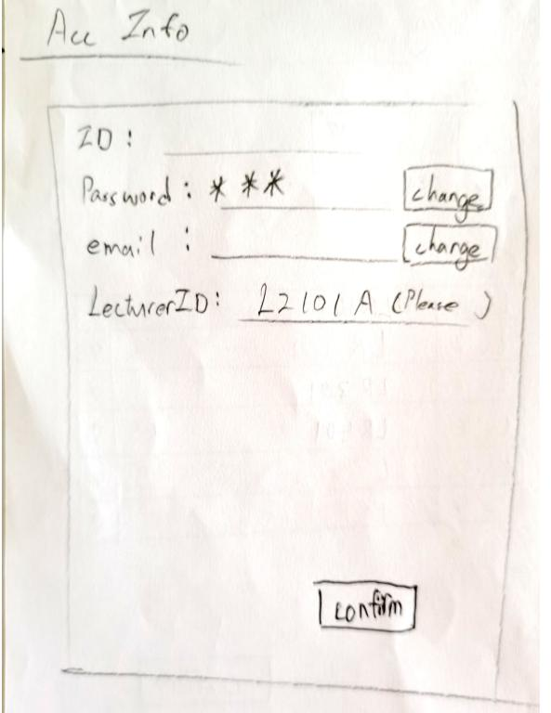
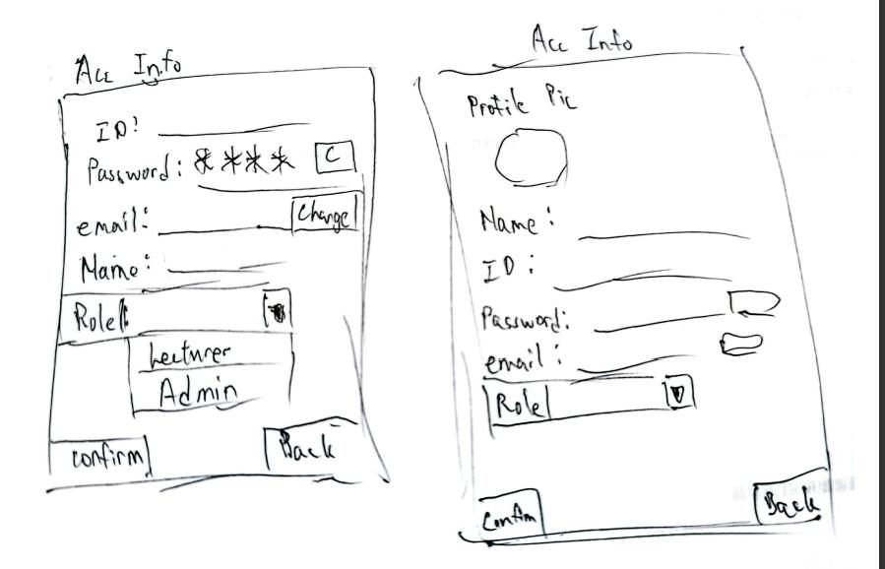
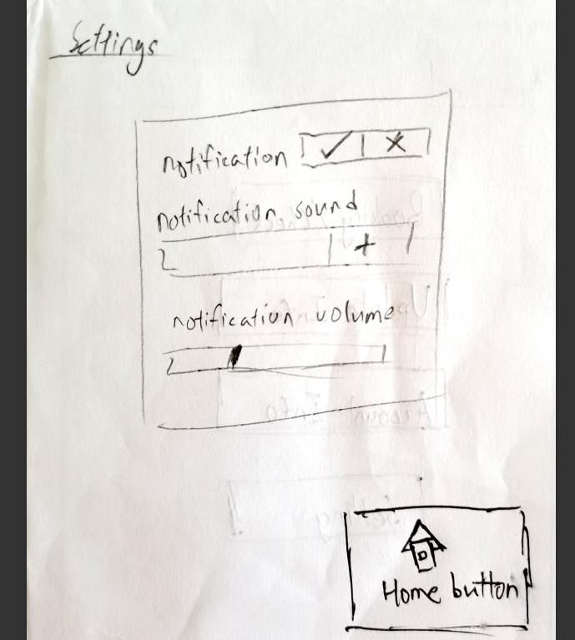
Methodology
(Low Fidelity Prototype)

Slide 12
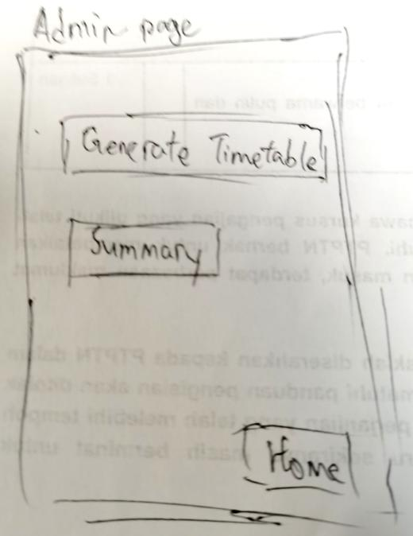
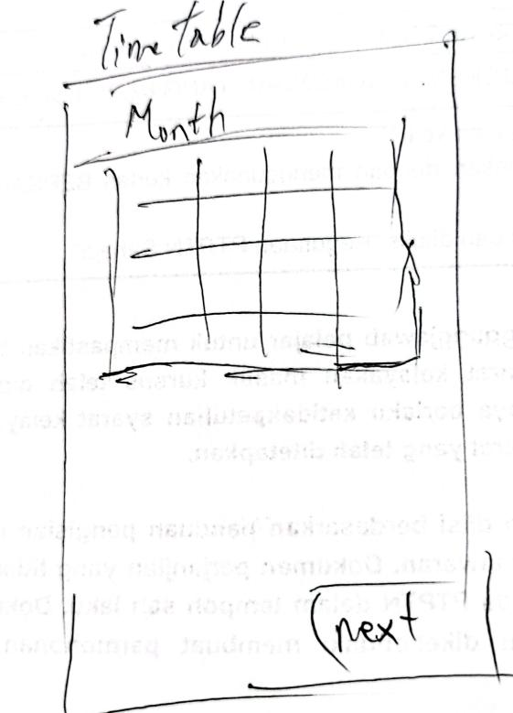
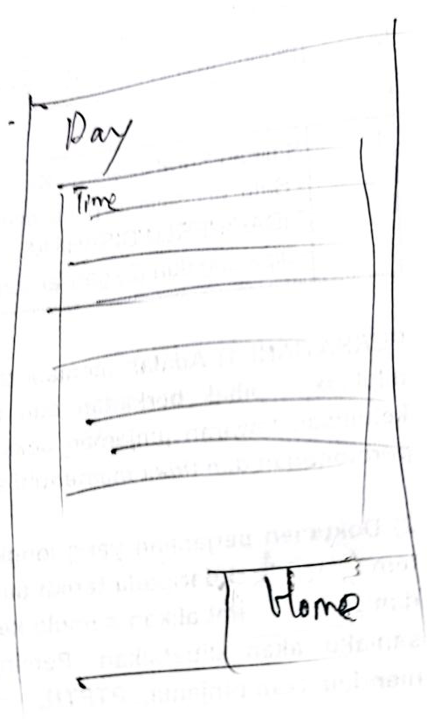
Methodology
(Low Fidelity Prototype)

Slide 13
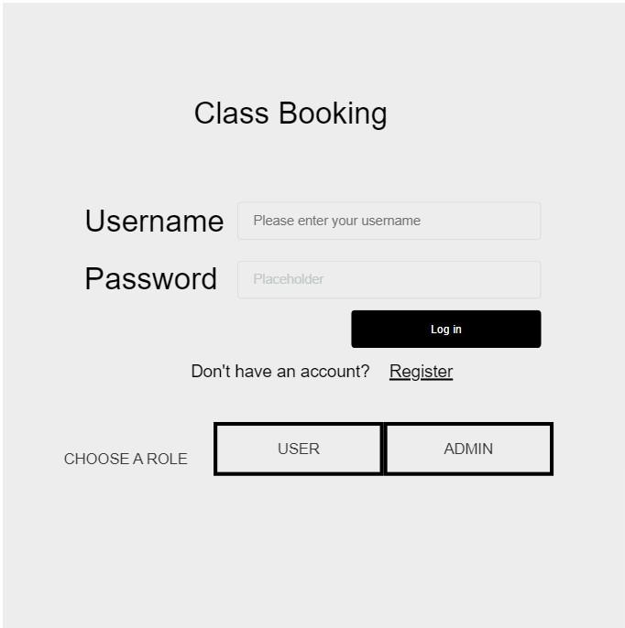
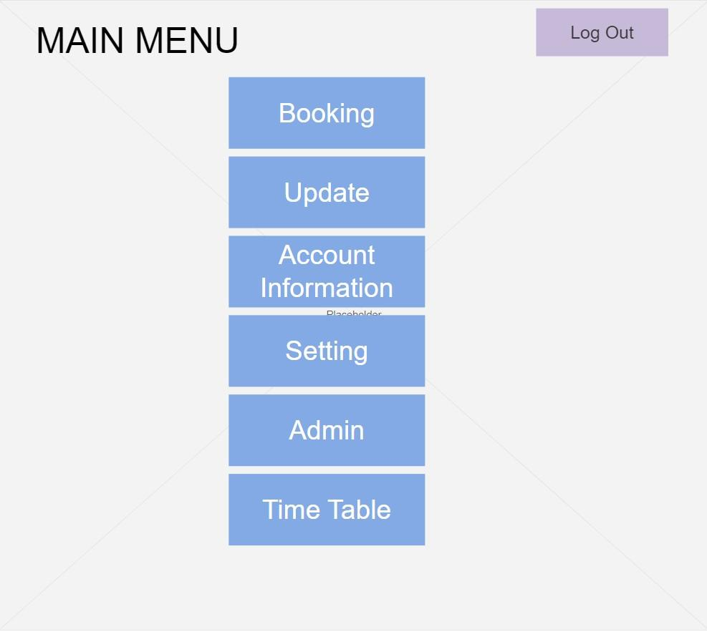
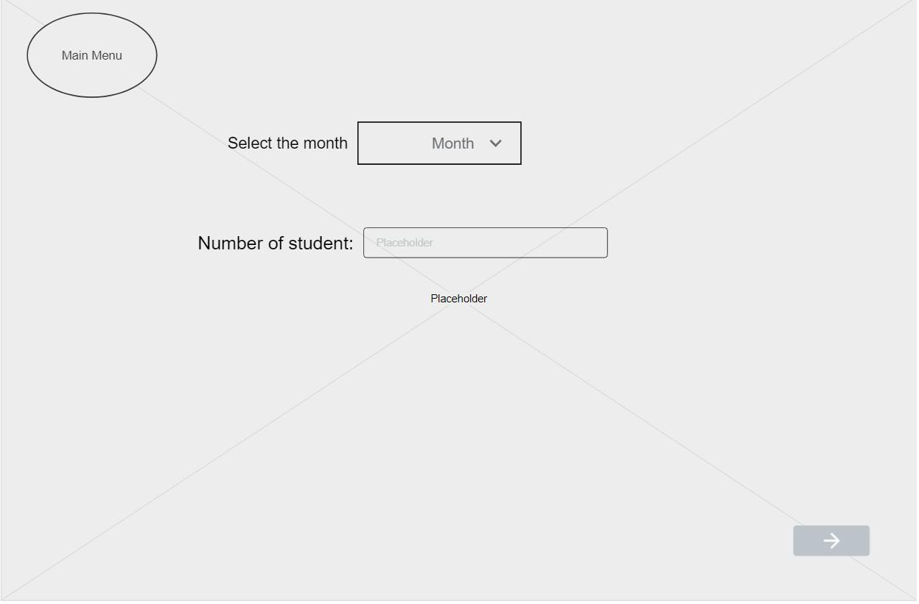
Methodology (High Fidelity Prototype)

Slide 14
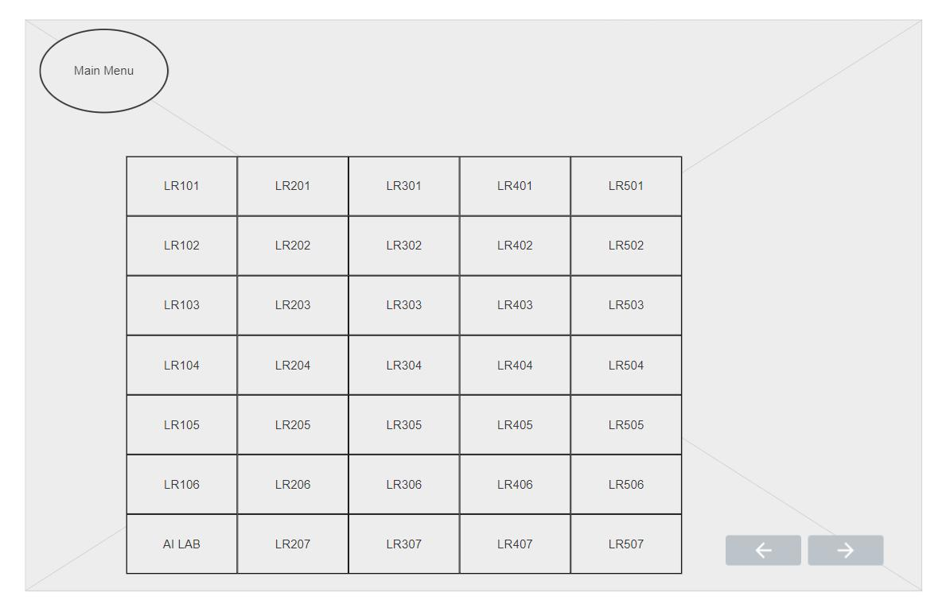
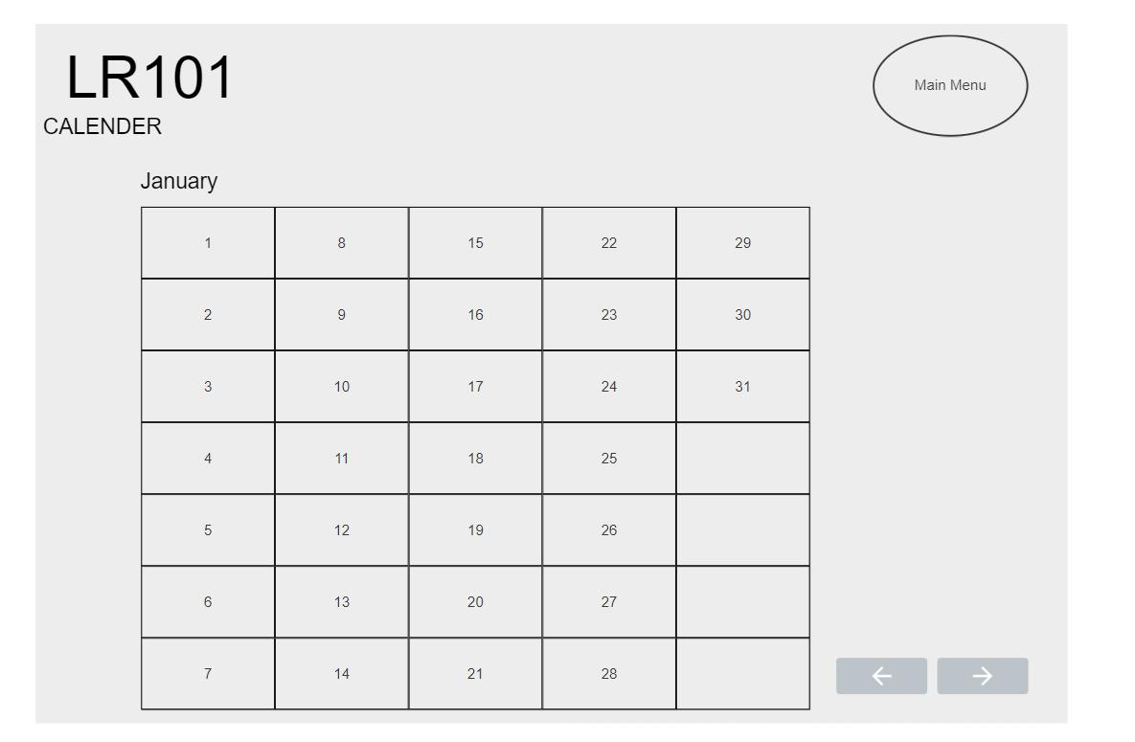
Methodology (High Fidelity Prototype)

Slide 15
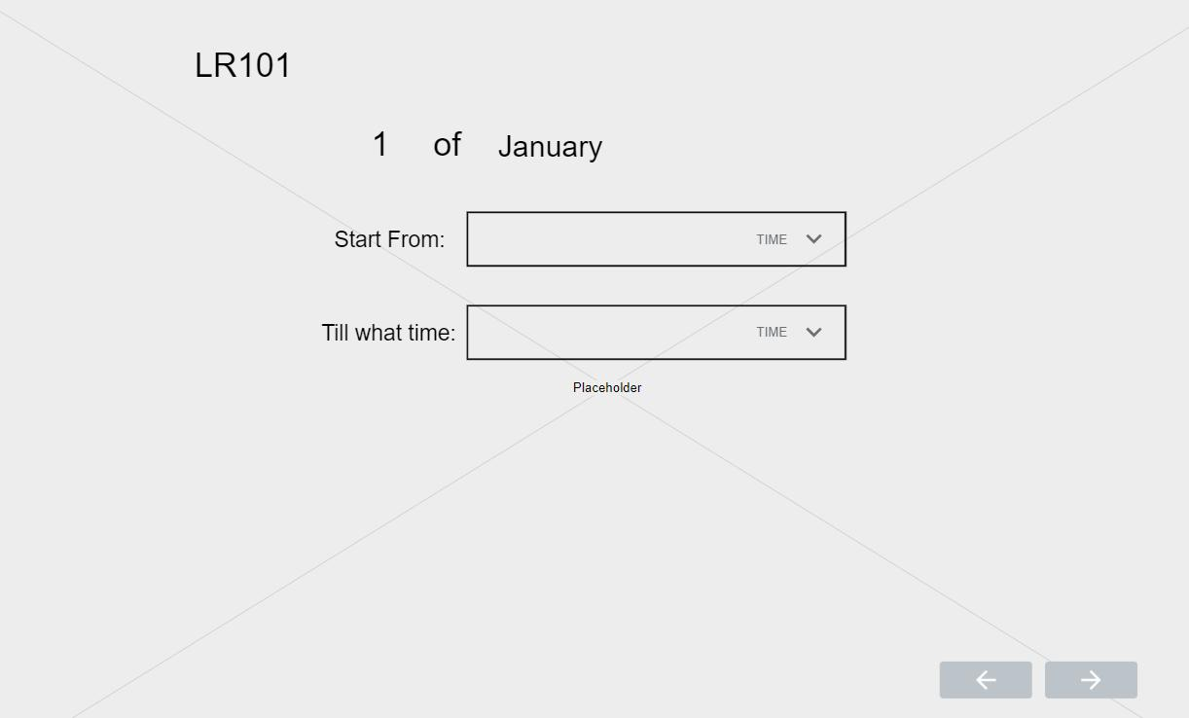
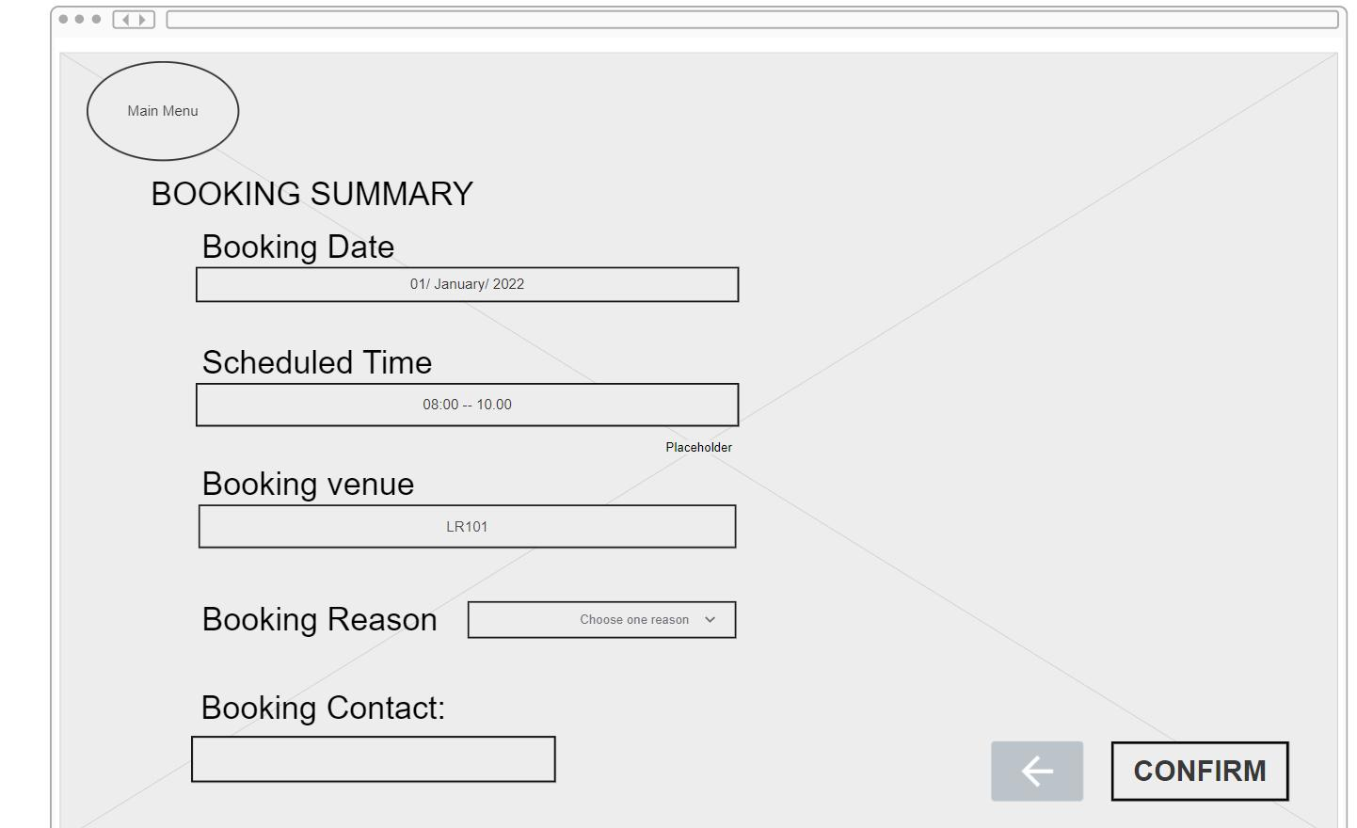
Methodology (High Fidelity Prototype)

Slide 16
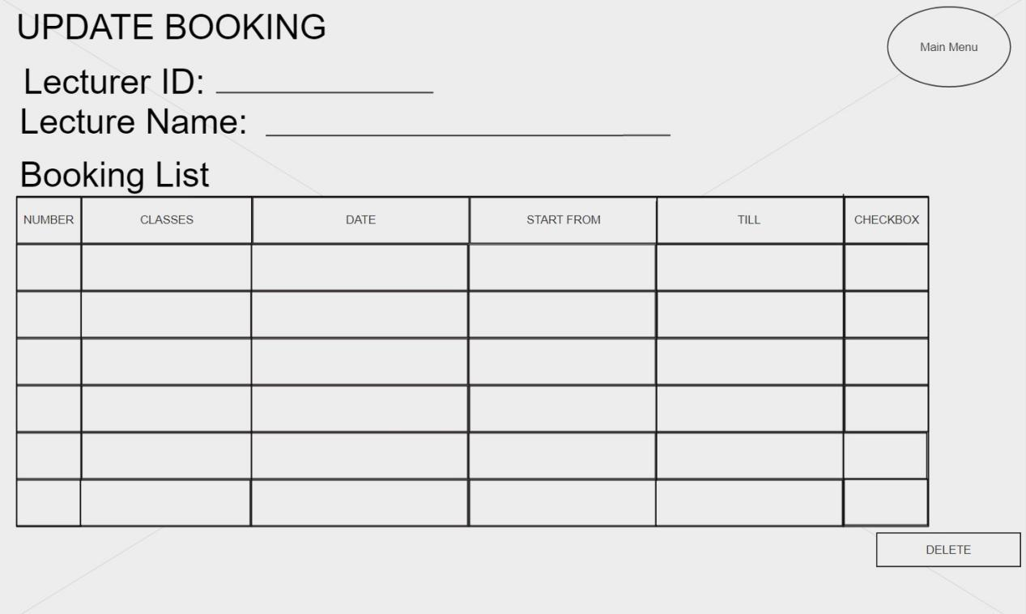
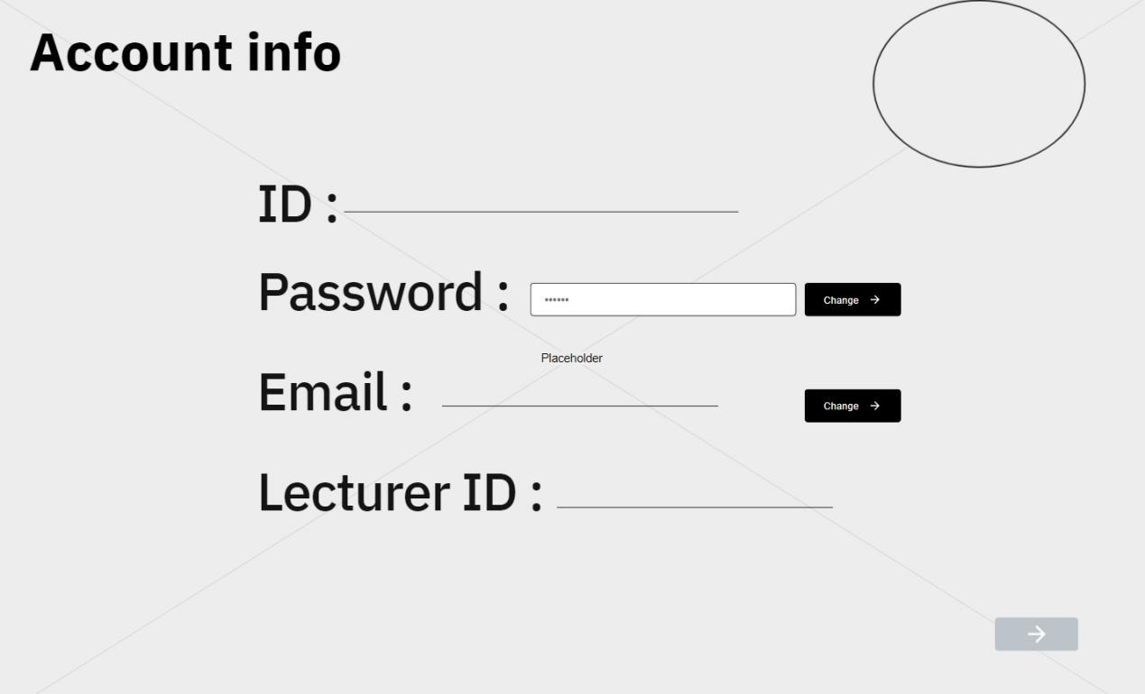
Methodology (High Fidelity Prototype)

Slide 17
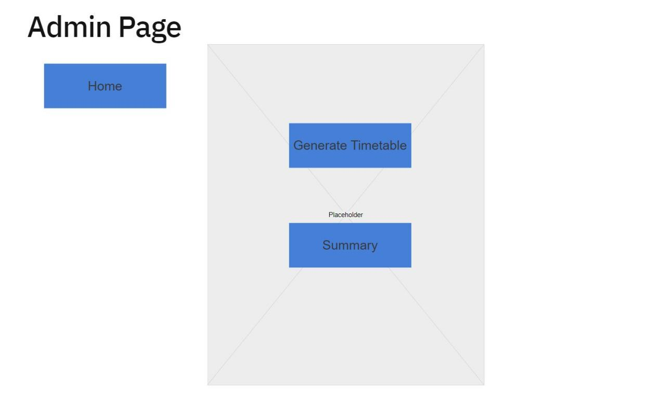
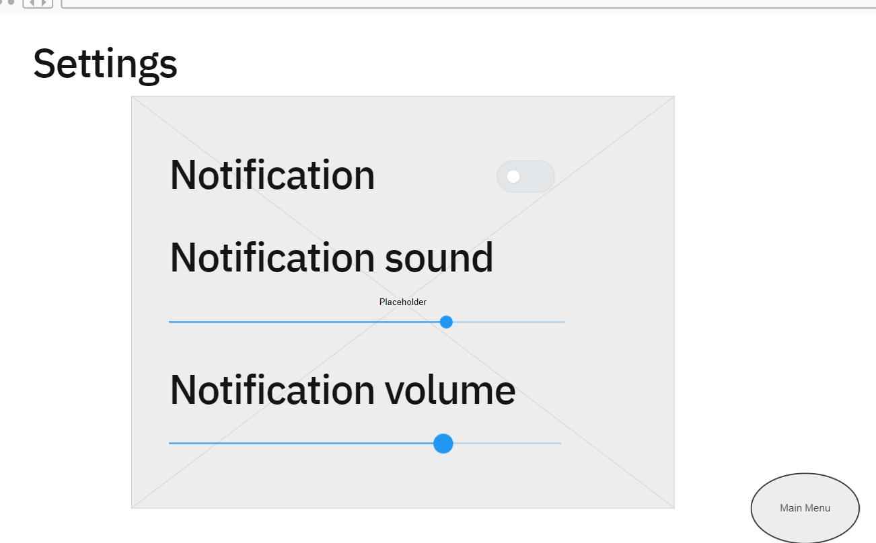
Methodology (High Fidelity Prototype)

Slide 18
Demo Video

Slide 19
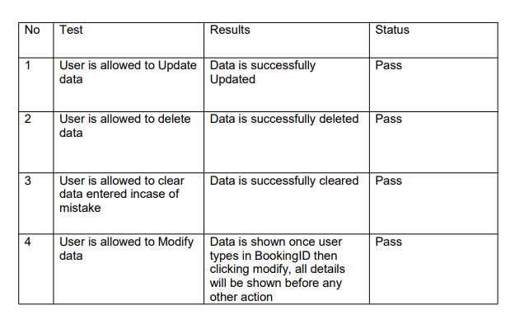
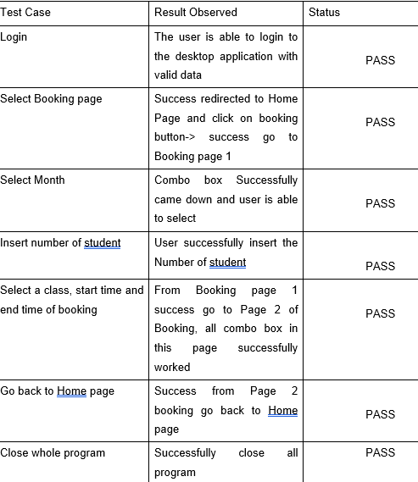
Usability testing

Slide 20
Future Improvement
We Hope that our system can be more complete in all function and ui could be more user friendly. Other than that, Data required could be more specific and include a timetable for both lecturer and by course timetable of student so that user can use that timetable to determine what time can they book for it.

